Slide 1


PREDICTING TELCO CUSTOMER CHURN
Reducing churn with data analytics
Chua Sok Peng
Eric Ng
Huang Yuqin
Joel Lim
John Tan
Sylvia Sin

Slide 2

TABLE OF CONTENTS
Introduction Data Loading & Cleaning
Exploratory Data Analysis
Feature Engineering
Building classification models
Features Impacting Churn
Recommendations

Slide 3

THE CLIENT A MAJOR S.E.A. TELECOM SERVICES PROVIDER
With prepaid and postpaid customer segments
A wide variety of product offers and plans

Slide 4

PROBLEM STATEMENT POSTPAID VOICE-ONLY SEGMENT IS LOSING A SECURE POSITION IN LOCAL MARKET
Decline in overall customer base – High churn rate combined with low acquisition rate
A Revenue Decline of ~USD500K per month
…leading to a decline in total market share

Slide 5
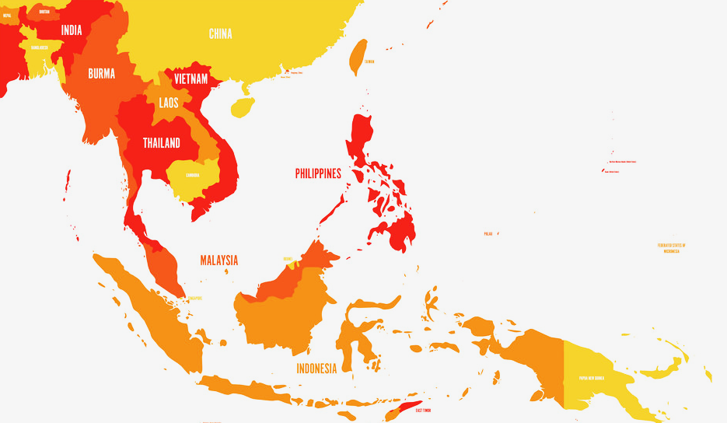
MARKET RESEARCH S.E.A. TELCO BUSINESSES HAVE BEEN SEEING HIGH CHURN RATES
Customer Churn Rates are higher than Acquisition Rates
30-35%
Average churn rate in the telco industry annually
Based on CustomerGauge’s B2B NPS and CX Benchmarks report
75%
sign-ups come from another telco (churners)
Source:
https://customergauge.com/blog/reducing-customer-churn-in-telecommunications
https://www.wipro.com/communications-/revenue-enhancement-and-churn-prevention-for-telecom-service-pro/
https://www.akkio.com/post/telecom-customer-churn
Notes:
Net Promoter Scores (NPS)

Slide 6
PROJECT OBJECTIVES REDUCE MONTHLY CUSTOMER CHURN
Build a classification model to predict churners
IDENTIFY HIGH-RISK CUSTOMERS
IN ADVANCE
Identify key churn drivers
Notes:
Build a classification model to predict churners, one month in advance

Slide 7
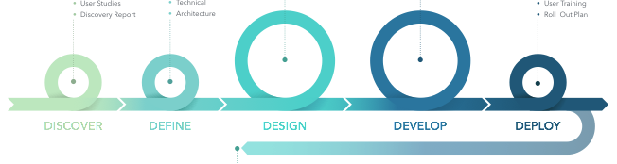
OUR APPROACH
THE 5D PROCESS
Strategic business insights must link with organisational corporate strategy.​
Strategic dataset is key in producing business insights.
Data analysis leads to insights. Turn those insights into decisions and actions that improve the business strategy. ​
For this project, we apply:
Develop
Design
Discover
Assess your current data and acquire external data if applicable.​
Clean, structure data and turn the data into information.​
Making strategic business decision. ​
Forecast and predict strategic decisions based on intelligence insight.
Understanding business strategy.
Identify focus area to improve and the required and relevant data.
Build model that predict business outcome based on business strategy.
Visual intelligence insights based on complex sets of data.
DEFINE
DEVELOP
DESIGN
DISCOVER
DECIDE
Notes:
Net Promoter Scores (NPS)

Slide 8

STAGE 1 LOAD AND
CLEAN THE DATA
Notes:
Exploratory Data Analysis

Slide 9
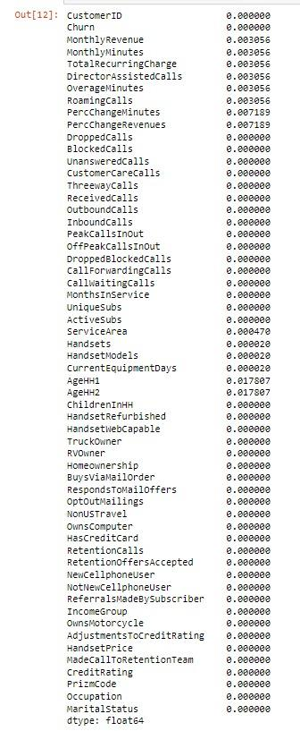
STAGE 1 LOAD AND CLEAN THE DATA
The dataset contains no duplicates.
There were 6 ‘zero’ observations found in ‘MonthlyRevenue’.
Action taken:
We removed
the rows containing zero.
There were no columns with missing values percentages > 5%.
Notes:
Check that there are no duplicates, But there were 6 zero found in Monthly Revenue column. There were no columns with missing values having a percentage >5%. Understanding - - get an understanding of the data structure, conduct initial preprocessing, clean the data, identify patterns and inconsistencies in the data (i.e. skewness, outliers, missing values) and build and validate hypothesis

Slide 10
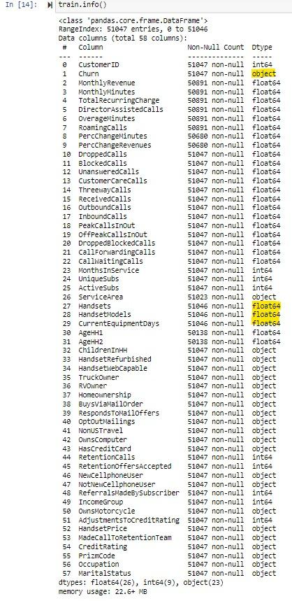
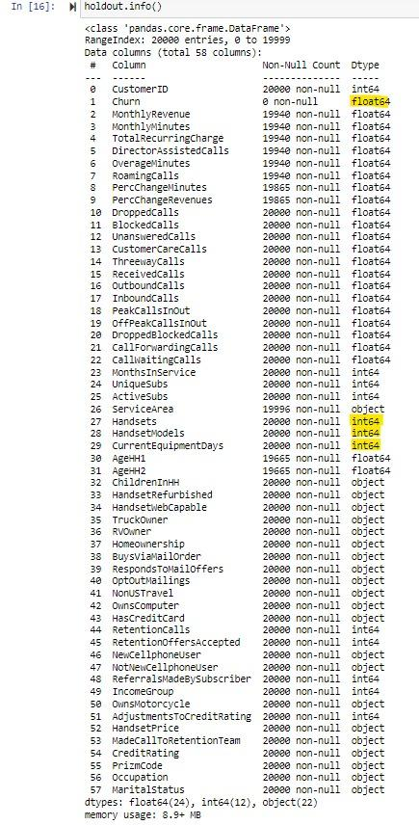
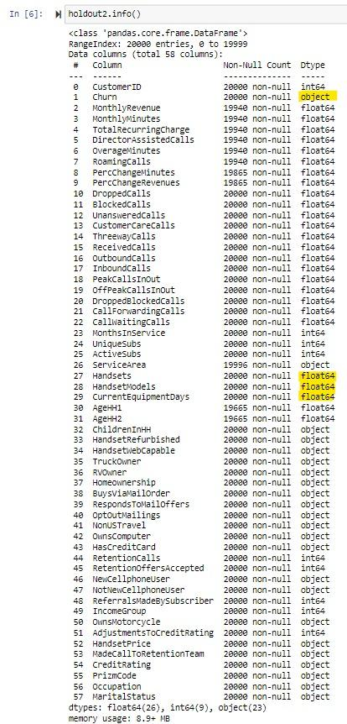
STAGE 1 LOAD AND CLEAN THE DATA
There was column data type inconsistency between ‘Train Data’ and ‘Holdout Data’ datasets.
Action taken:
We corrected the data types in the ‘Holdout Data’, with the same parameters as ‘Train Data’.
train
holdout
train
holdout
BEFORE CORRECTION
AFTER CORRECTION
Notes:
There was inconsistency in data type between Train Data and Holdout Data

Slide 11
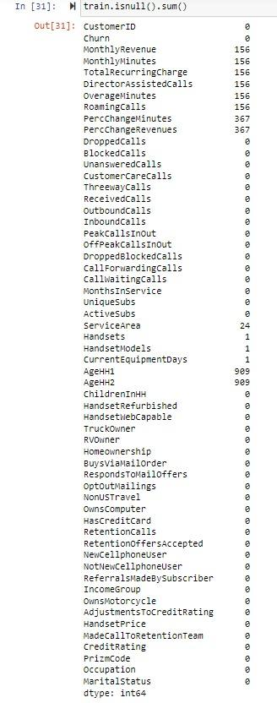
STAGE 1 LOAD AND CLEAN THE DATA
Nulls were found in these columns:
MonthlyRevenue | MonthlyMinutes
PercChangeMinutes | PercChangeRevenues
ServiceArea | Handsets
HandsetModels | CurrentEquipmentDays
AgeHH1 | AgeHH2
Action taken:
We removed the rows containing Nulls.
Notes:
MonthlyRevenue - Monthly revenue in USD
MonthlyMinutes - Monthly minutes
PercChangeMinutes - percentage change in minutes from previous month
PercChangeRevenues - percentage change in revenue from previous month
ServiceArea - Service area of the subscription
Handsets - Total # of handsets
HandsetModels - total # of unique handset model
CurrentEquipmentDays - Number of days since the activation of current equipment
AgeHH1 - Primary holder
AgeHH2 - Secondary holder

Slide 12
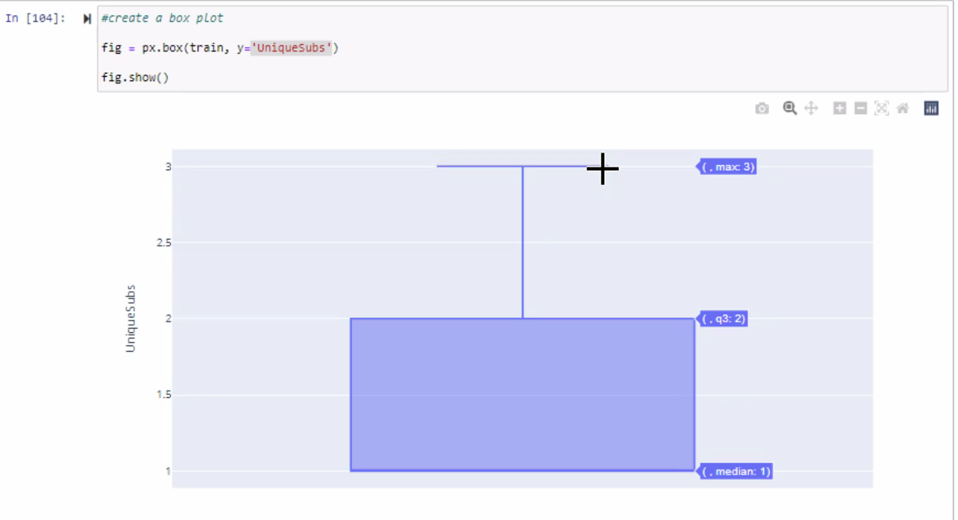
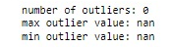
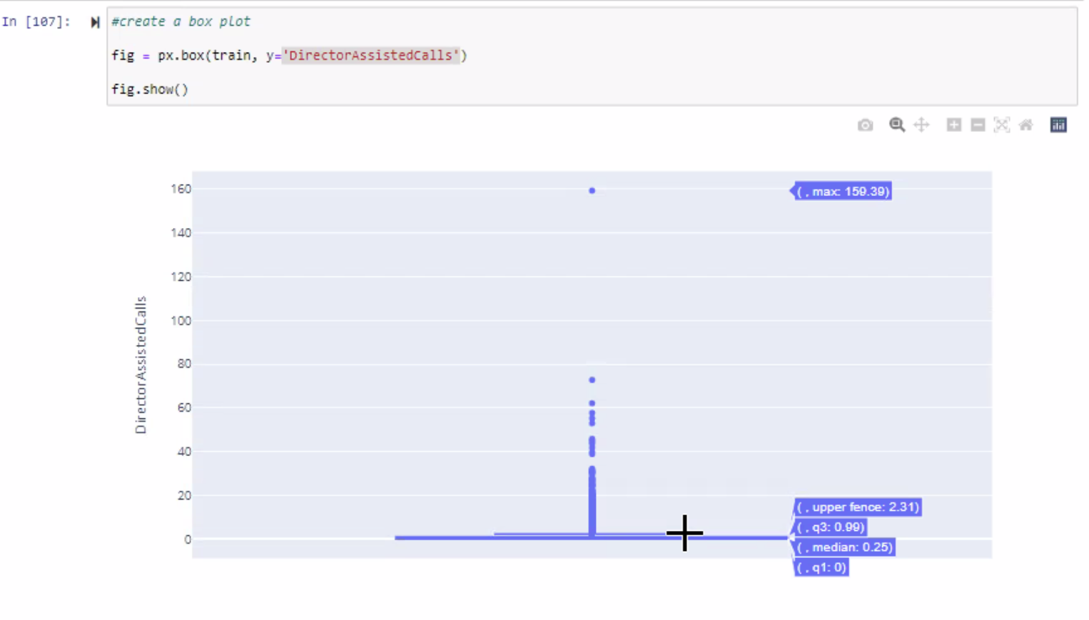
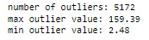
STAGE 1 LOAD AND CLEAN THE DATA
No outliers in ‘UniqueSubs’ column.
Outliers were found in ‘DirectorAssistedCalls’, column.
Notes:
We applied the IQR method to check for outliers (if values are way outside the IQR borders)
No outliers were found in UniqueSubs column but Outliers were found in DirectorAssistedCalls column

Slide 13
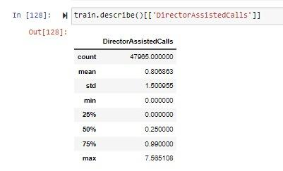
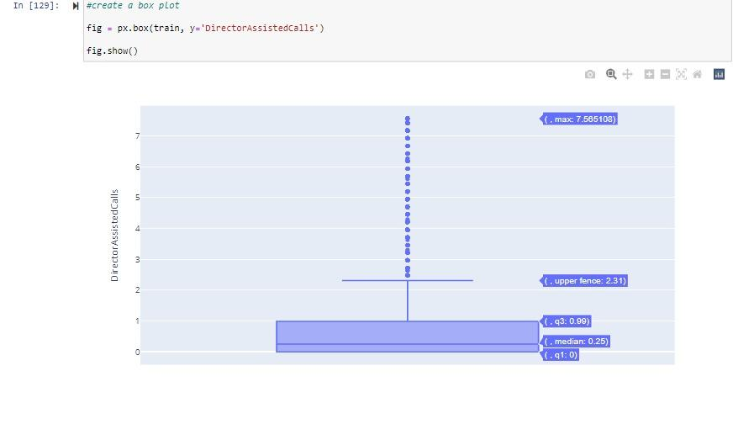
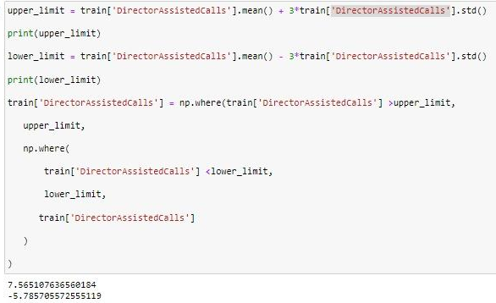
STAGE 1 LOAD AND CLEAN THE DATA
To resolve the outliers in ‘Director AssistedCall’, we used Mean + 3 Std, and went with the upper limit of 7.565, at which we capped.
By capping the outliers, we assumed that all outliers express the same behaviors (i.e. the model would not learn anything new by allowing outliers to remain).
Updated boxplot after capping
Notes:
To resolve the outliers in.. As there are alot of outliers (5172), we cap the outliers - assumed all outliers express the same behaviours.

Slide 14

STAGE 2 ANALYSE
THE DATA
Notes:
EXPLORATORY DATA ANALYSIS

Slide 15
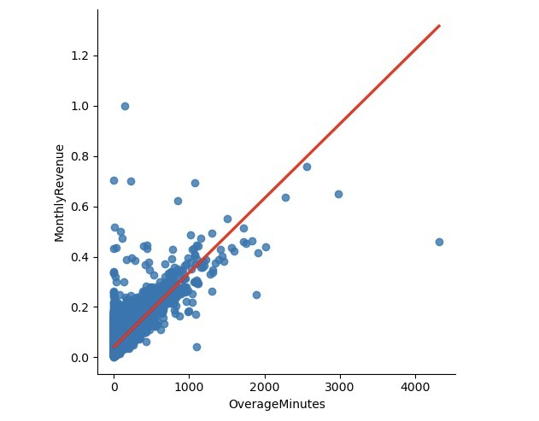
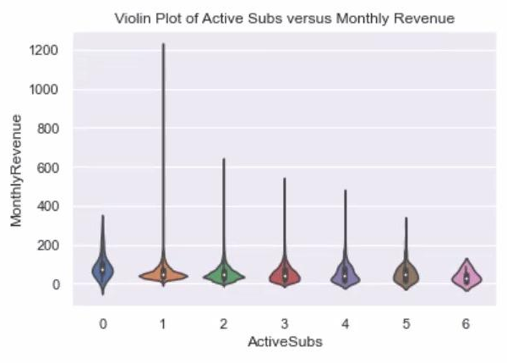
STAGE 2 ANALYSE THE DATA
The scatterplot below shows that customers with high overage minutes also have high revenue.
From the violin plot, we see that high number of active subs lead to lower monthly revenue.
Notes:
EXPLORATORY DATA ANALYSIS

Slide 16
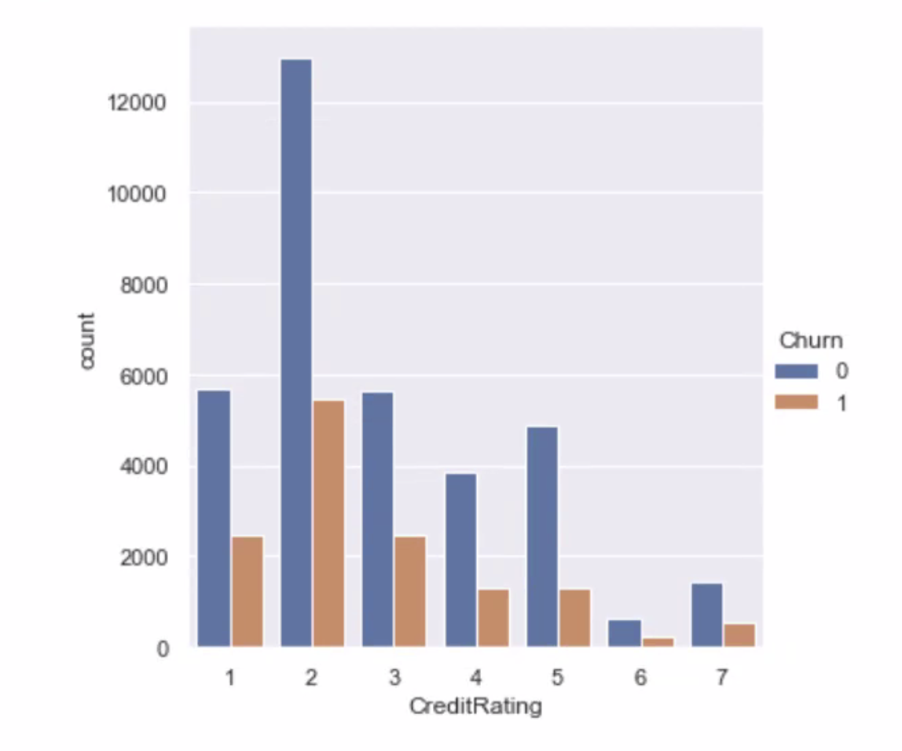
STAGE 2 ANALYSE THE DATA
From the categorial plot on the right, it shows that the churn rate is larger on high credit ratings and that churning occurs for each credit rating.
Notes:
1 = Largest credit rating
7 = Lowest credit rating

Slide 17

STAGE 3 DEEP DIVE WITH FEATURE ENGINEERING
Notes:
FEATURE ENGINEERING
Create the following additional features to help predict churn

Slide 18
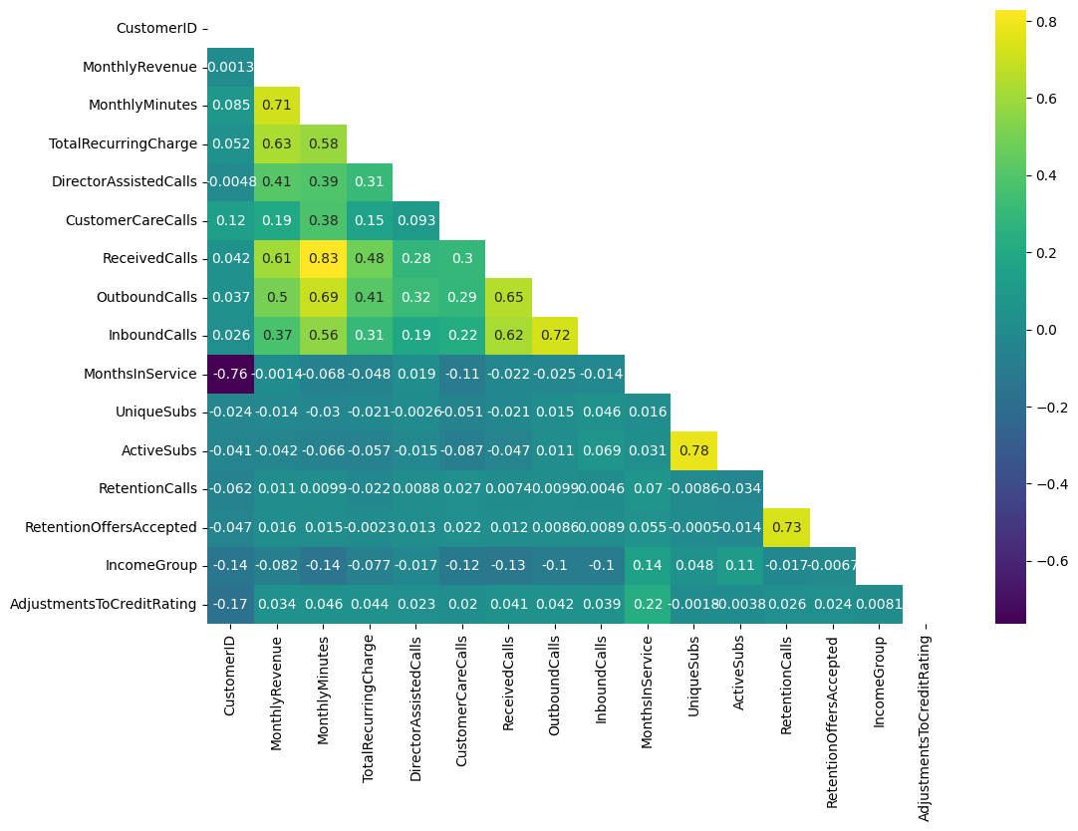
STAGE 3 DEEP DIVE WITH FEATURE ENGINEERING
Using Correlation to Identify Possible Intuitive Features
Notes:
Help to identify intuitive feature by looking at correlation between a pair of variables

Slide 19
STAGE 3 DEEP DIVE WITH FEATURE ENGINEERING
These additional features were created to predict churn:
1
2
3
Percent of current active subs over total subs
Percent of recurrent charge to monthly charge
Percent of overage minutes over total monthly minutes
Notes:
FEATURE ENGINEERING
Create the following additional features to help predict churn
The results for this task will be reflected in the following slides.

Slide 20
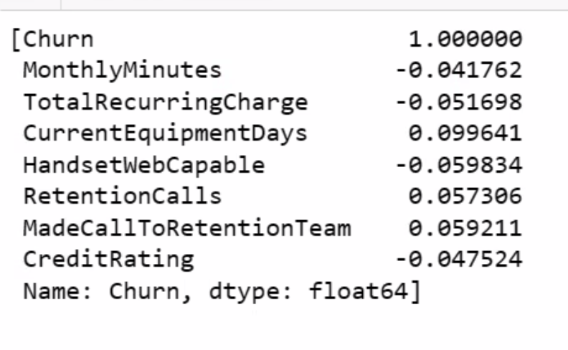
STAGE 3 DEEP DIVE WITH FEATURE ENGINEERING
Some of the intuitive features which can be considered:
1
2
3
4
5
Percent of dropped calls minutes over total monthly minutes
Percent of blocked calls minutes over total monthly minutes
Percent of unanswered calls minutes over total monthly minutes
Percent of customer care calls minutes over total monthly minutes
Percent of roaming calls minutes over total monthly minutes
Notes:
FEATURE ENGINEERING
Create the following additional features to help predict churn
1) Percent of dropped calls minutes over total monthly minutes
2) Percent of blocked calls minutes over total monthly minutes
3) Percent of unanswered calls minutes over total monthly minutes¶
4) Percent of customer care calls minutes over total monthly minutes
5) Percent of roaming calls minutes over total monthly minutes

Slide 21

STAGE 4 BUILD CLASSIFICATION MODELS
Notes:
Situation - Complication - Question (SCQ)
Frame: What are the key pain points? Telco Customer Churn rate is high
Generate hypothesis: focused, specific
Hypothesis tree: MECE mutually exclusive collectively exhaustive
Churn: percentage of customers who stopped using company’s services within 1 year

Slide 22
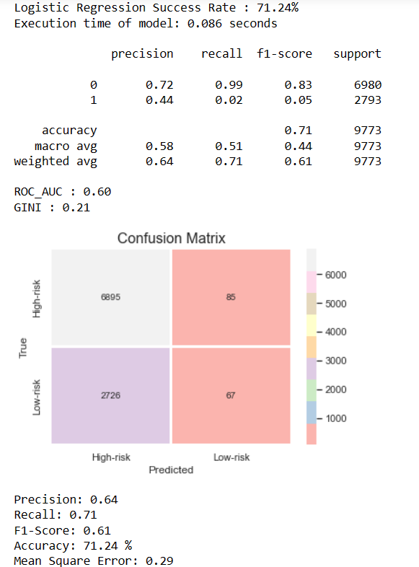
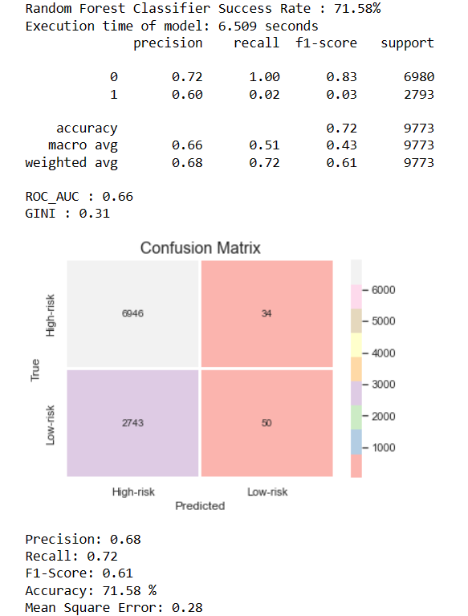
STAGE 4 BUILD CLASSIFICATION MODELS
Predictive Modelling Using Logistic Regression vs RF
Notes:
The Gini Coefficient is 2*AUC – 1 and its purpose is to normalize the AUC so that a random classifier scores 0, and a perfect classifier scores 1. The range of possible Gini coefficient scores is [-1, 1]
AUC is good for classification problems with a class imbalance.
AUC scoring lets us evaluate models independently of the threshold.
AUC is not directly comparable to accuracy, precision, recall or F1-score.

Slide 23
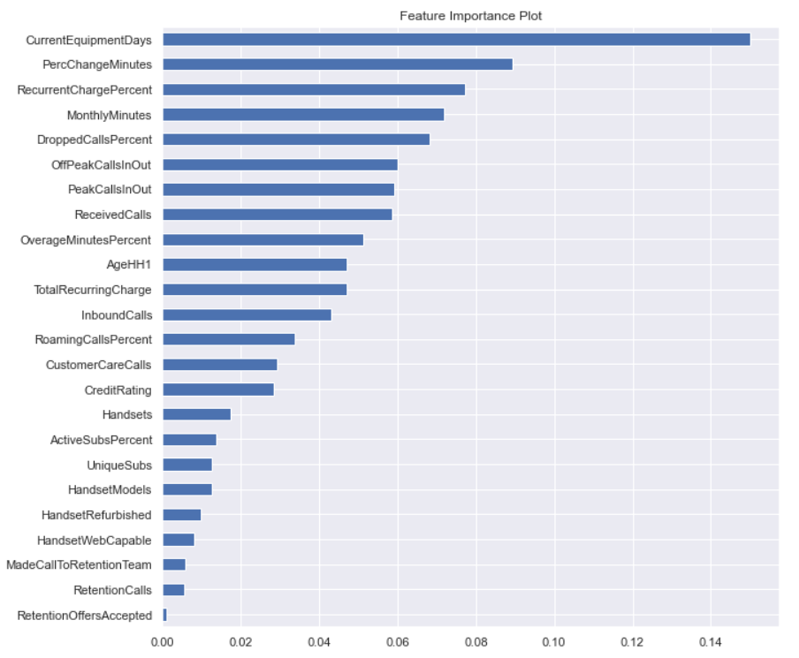
STAGE 4 BUILD CLASSIFICATION MODELS
Feature Importance Plot

Slide 24
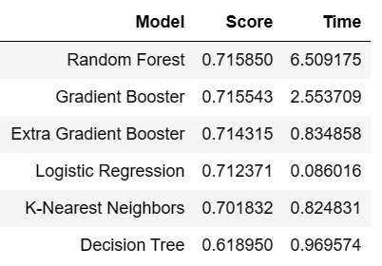
STAGE 4 BUILD CLASSIFICATION MODELS
Model Selection
Based on the confusion matrix, we will select Random Forest Classifier model for its powerful predictive capability since it has the best accuracy result, ROC_AUC and F1 scores, even though its execution time is much longer.

Slide 25
STAGE 4 BUILD CLASSIFICATION MODELS
Summary of Findings
Proposed to use Random Forest Model over Logistic Regression Model due to better AUC mean score and F1 score.
Tuning Model Hyperparameters for Random Forest using GridSearchCV to enhance model performance.
Logistic Regression is easier to implement, interpret and very efficient to train as well as very fast at classifying unknown dataset. However, non-linear problems cannot be solved with Logistic Regression because it has a linear decision surface.
Logistic Regression is not immune to missing data unlike Random Forests which are based on trees. This usually means extra work on data regarding processing missing values. It can also be prone to overfitting and to avoid this tendency, a larger training data and regularization can be introduced.
Notes:
Advantages and Disadvantages of Random Forest
It reduces overfitting in decision trees and helps to improve the accuracy
It is flexible to both classification and regression problems
It works well with both categorical and continuous values
It automates missing values present in the data
Normalising of data is not required as it uses a rule-based approach.
However, despite these advantages, a random forest algorithm also has some drawbacks.
It requires much computational power as well as resources as it builds numerous trees to combine their outputs.
It also requires much time for training as it combines a lot of decision trees to determine the class.
Due to the ensemble of decision trees, it also suffers interpretability and fails to determine the significance of each variable.

Slide 26
STAGE 4 BUILD CLASSIFICATION MODELS
Machine Learning (ML) Pipeline
Problem Definition
Exploratory Data Analysis (EDA) and Visualisations Correlation, Feature Importances, VIF
Data Ingestion
Model Instantiation Min Max Scalar, Train, Test Split, fit model
Data Preparation (Outliers)
Feature Engineering
Model Training Random Forest Classifier
Model Validation K-fold CV, Hyperparameter Tuning, Best model parameters
Model Evaluation Scores Accuracy, Confusion matrix, AUC
Deployment

Slide 27

FINDINGS FEATURES IMPACTING CHURN
Notes:
Situation - Complication - Question (SCQ)
Frame: What are the key pain points? Telco Customer Churn rate is high
Generate hypothesis: focused, specific
Hypothesis tree: MECE mutually exclusive collectively exhaustive
Churn: percentage of customers who stopped using company’s services within 1 year

Slide 28
CONSIDERATION POSSIBLE AFFECTING FACTORS
Attractive price plans from competitors
Customer buying preferences have changed
Customer Experience (CX) less than satisfactory
New technologies offered by competitors
Aggressive discounting from new entrant
Changing demographics of customer segments
Network coverage and reliability
Mobile phones
with advanced technology
Enticing offers from incumbent telcos
Suboptimal product mix
Service quality of customer service officers
Networks with
faster speeds
Source: https://www.wipro.com/communications-/revenue-enhancement-and-churn-prevention-for-telecom-service-pro/

Slide 29


Risks and Challenges
RISKS
CHALLENGES
Large Dataset - 58 columns | VIF to address
Many features to consider
Outliers | Random Forest

Slide 30



RECOMMENDATIONS FOR FUTURE ANALYSIS
Analyse the factors that influence or drive the retention of our clients.
Include the analysis time-series data on the market share of our company and its competitors to produce more realistic performance projections.
Include more sociodemographic data to better understand the nature of our clientele and the determinants of churning rate.
Notes:
Show more love to loyal customers

Slide 31
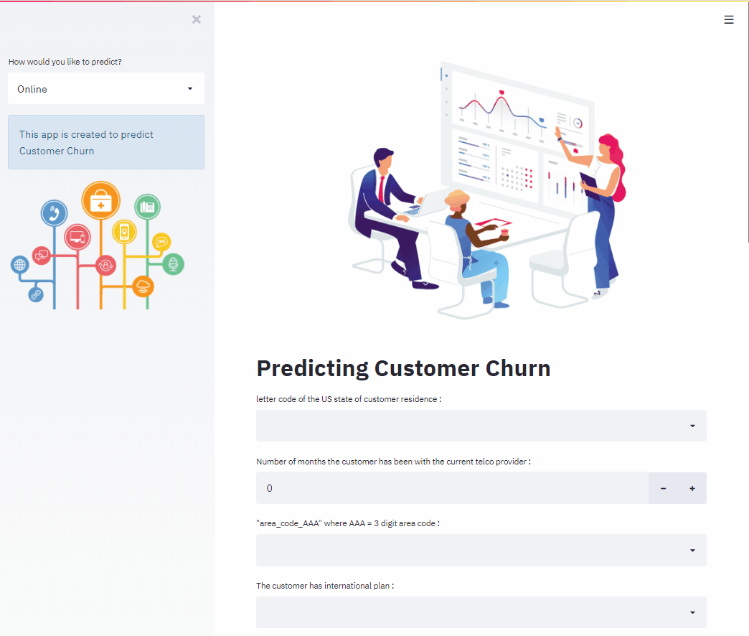
SPOT INFERENCE PREDICTING CUSTOMER CHURN

Slide 32


